Slide 1
CS 170 segment 3
Notes based from Dr. Eamonn Keogh

Slide 2
Use the 8 piece puzzle to compare algorithms we have learned about…
Breadth first search
Depth first search
Depth limited search
Iterative Deepening

Slide 3
How to read my figures

Slide 4
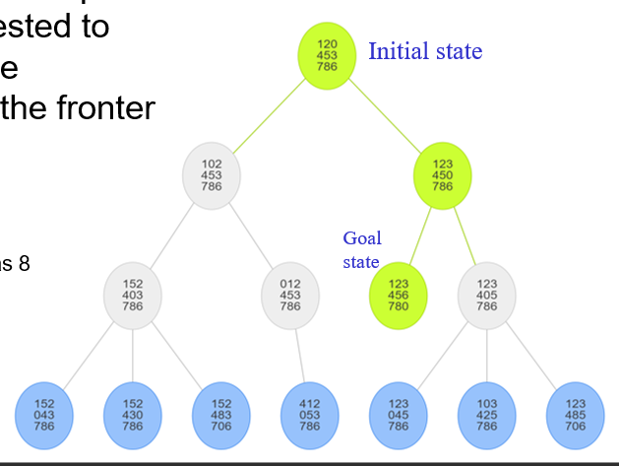
How to read his figures
Key
Green: Nodes on the solution path
Gray: Nodes that were tested to see if they were goal state
Blue: Nodes currently in the fronter (in nodes queue)
Solved! Depth: 2
Expanded nodes: 6
Fronter nodes: now 7, the maximum was 8

Slide 5
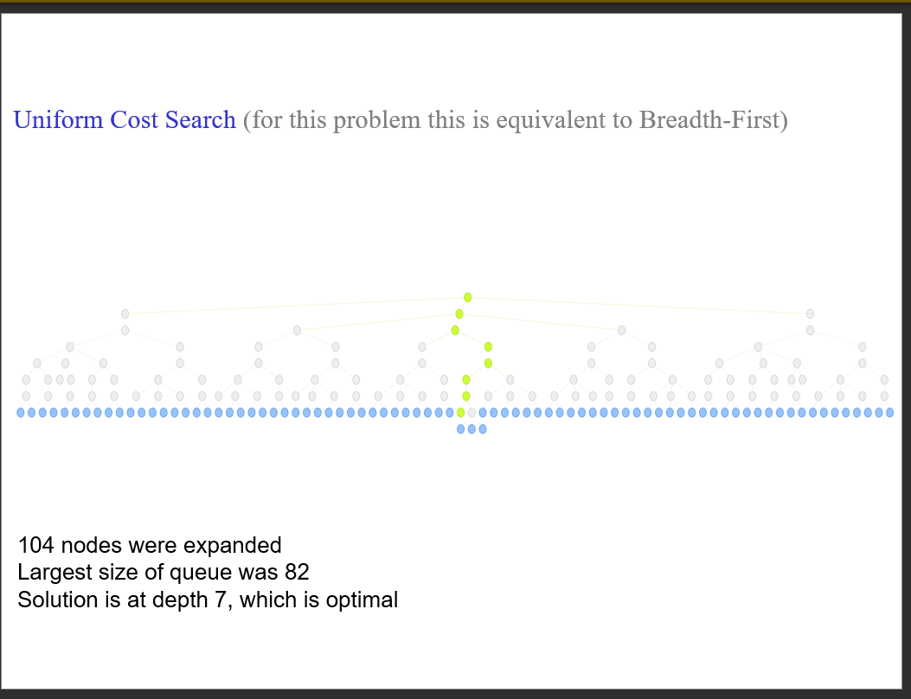

Slide 6
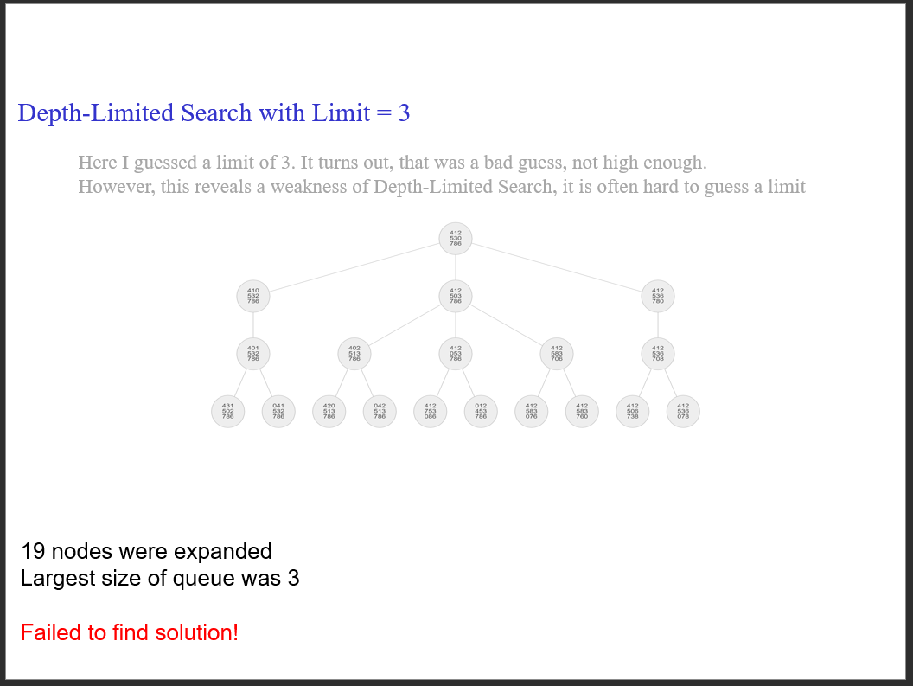

Slide 7
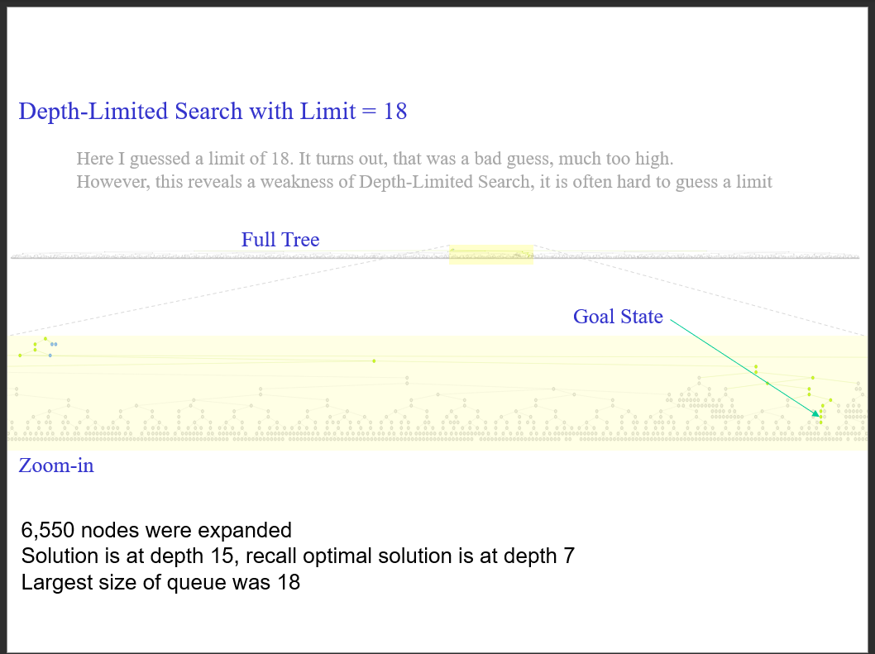

Slide 8
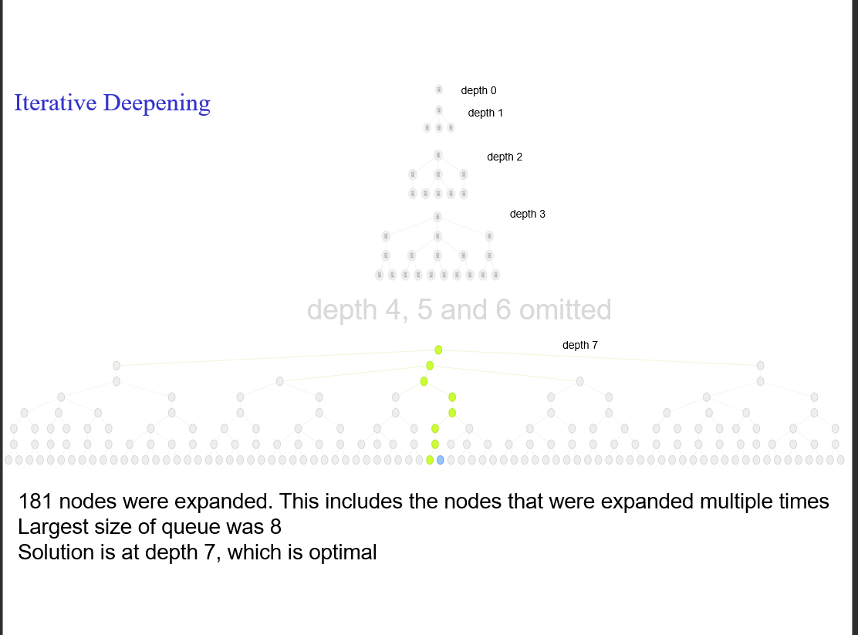

Slide 9
Depth-First
If we do this search without checking for repeated states, in general it will run forever
If we check repeated states, then we may have to expand up to 181,440 nodes, the full size of the problem space
Recall that even if we do check repeated states
We need memory of the order of 181,440 (to keep track of repeated states
We may not find the optimal solution

Slide 10
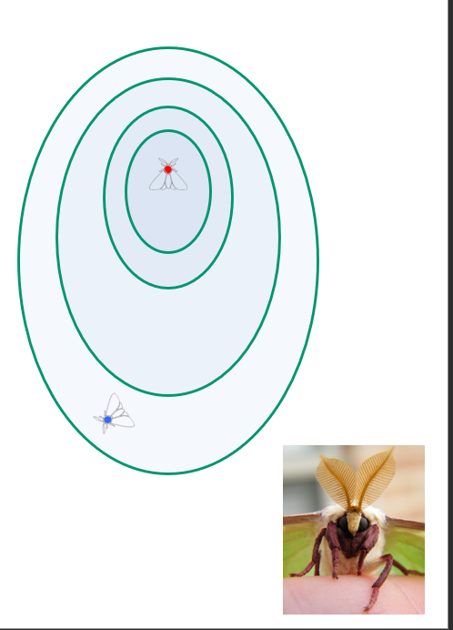
An apparent digression
The male moth needs to find a female. The female may be up to five miles away!
Like all insects, moths have rather poor vision. In any case, most moths fly at night
However, moths have an excellent sense of smell
The female releases a pheromone, which spreads around her in a plume
The plume spreads out in concentric circles, with a gradient reflecting the distance from the female
Let us see how a male searches for a female. It may have implications for our use of search

Slide 11
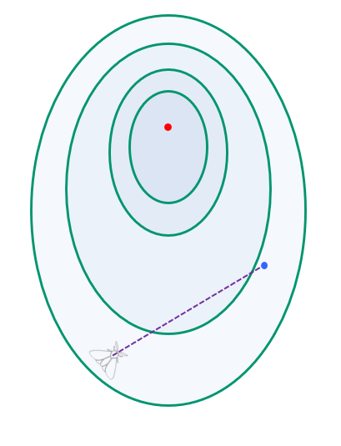
The moth has a vague idea of how far the female is from the strength of the smell
Lets call his prediction DIST
Note that DIST is only distance, it has no directional information
Ok, we are now ready to see the moth’s algorithm
Begin Algorithm:
He flies in a straight line, in a random direction (this is called casting)
He remembers how strong the smell is along the straight path…

Slide 12
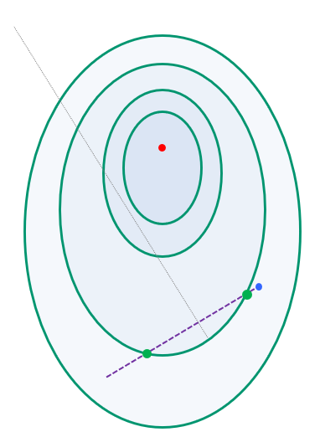
…he remembers two locations that have about equal strength (green) dots
He creates a bisector line (find dashed line) to a line connecting the two green dots
This can be seen as a guess as to the direction of the female, she is close to the line somewhere

Slide 13
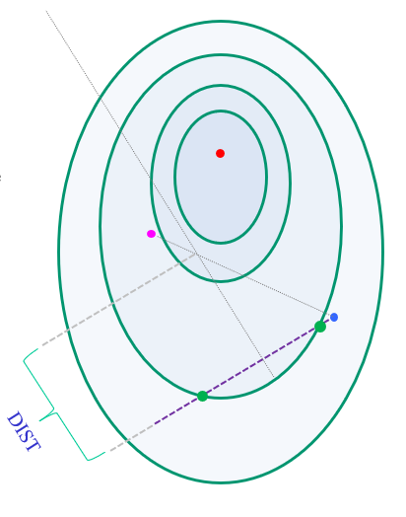
… he remembers two locations that have about equal strength (green) dots
He creates a bisector line (find dashed line) to a line connecting the two green dots
This can be seen as a guess as to the location of the female, she is close to the line somewhere
The male already has an idea as to how far away she is, DIST
So he flies to a point that is a little past DIST on his bisector , the pink dot. This is called surging

Slide 14
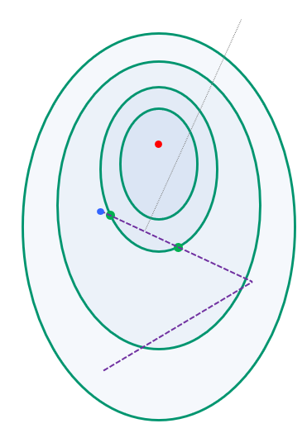
On his way to the pink dot, he remembers the strength of the smell
In particular, he remembers two new locations that have about equal strength of smell, two new green dots…
The moth can simply repeat the algorithm until he finds the female

Slide 15
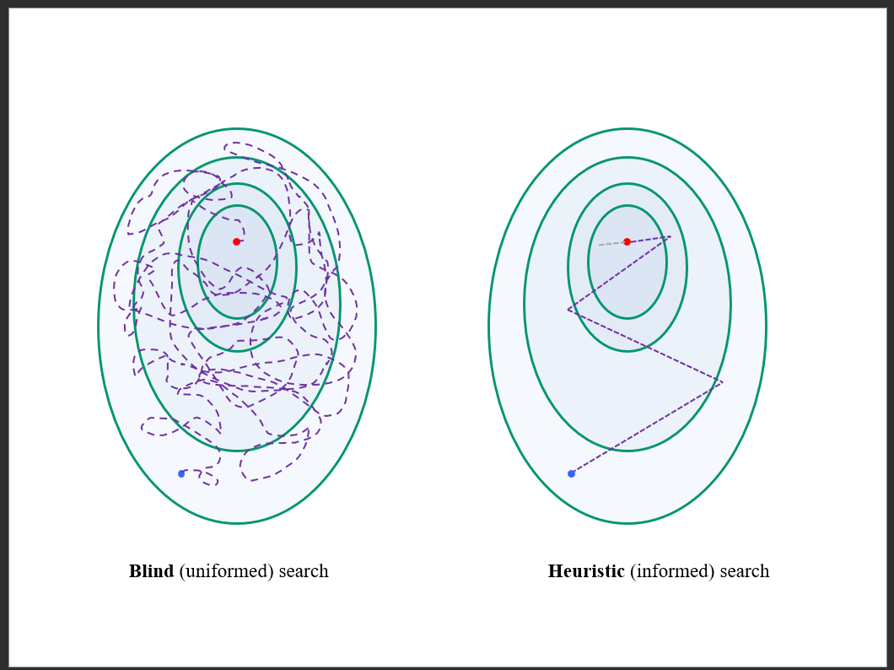

Slide 16
Takeaway message
Blind (uniformed) search can be very very inefficient
Heuristic (informed) search can be very efficient. This is true even if the information is very weak
If we extend this analogy to AI search, it suggest that if we can just give the search algorithm some hints about how close it is to the goal, this might greatly improve search

Slide 17
Heuristic Search
The search techniques we have seen so far…
Breadth first search / Uniform cost search
Depth first search
Depth limited search
Iterative Deepening
Bi-directional search
…are all too slow for most real-world problems

Slide 18
Heuristic Search (informed search)
A Heuristic is a function that, when applied to a state, returns a number that is an estimate of the merit of the state, with respect to the goal. We write it as h(n)
In other words, the heuristic tells us approximately how far the state is from the goal state*
Note we said “approximately”. Heuristics might underestimate or overestimate the merit of a state. But for reasons which we will see, heuristics that only underestimate are very desirable, and are called admissible

Slide 19
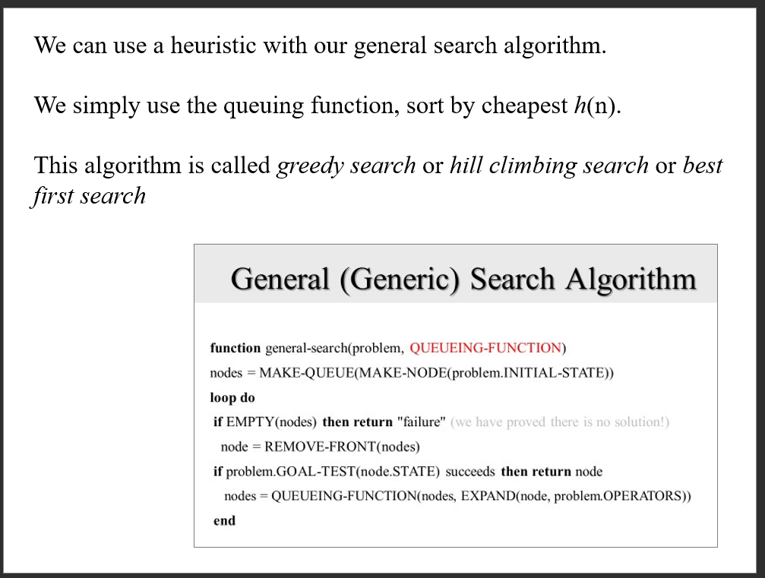

Slide 20
We have seen two interesting algorithms
Uniform Cost
Measures the cost to each node from the initial state
Is optimal and complete!
Can be very slow
Hill climbing (best-first, Greedy)
Estimates how far away the goal is
Is neither optimal nor complete
Can be very fast
Can we combine them to create an optimal and complete algorithm that is also very fast?

Slide 21
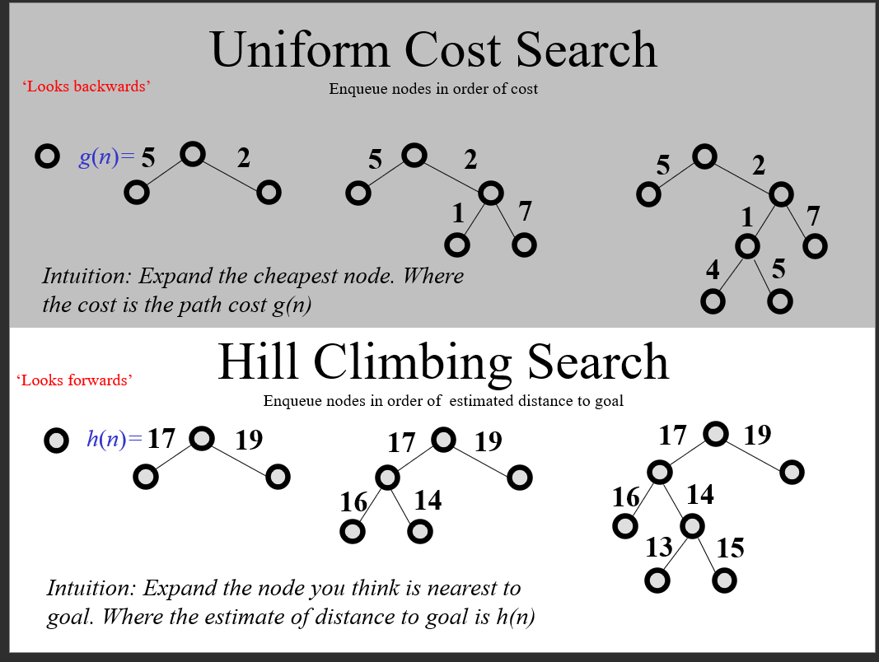

Slide 22
The A* Algorithm (“A-Star”)
g(n) is the cost to get to a node
h(n) is the estimated distance to the goal
f(n) = g(n) + h(n) -think of f(n) as the estimated cost of the cheapest solution that goes through node n
Note that we can use the general search algorithm we used before. All that we have changed is the queuing strategy
If the heuristic is admissible, that is to say, it never overestimates the distance to the goal, then…
A* is optimal and complete!

Slide 23
Discussion of Heuristics
The h(n) of the goal state must be zero
However, if the h(n) is zero, it doesn’t necessarily mean that we are at the goal state (it might for some heuristics, but it is not true in general)
If we hardcode a heuristic to always return zero, A* becomes uniform cost search
In general, we want a heuristic to be “tight”. That is to say, be as close to the true distance to the solution as possible (without going over).
Suppose we discover that for all n, h_{Misplacedtile}(n) ≤ h_{Manhattan}(n)
Then the Manhattan heuristic is said to dominate the misplaced tile heuristic, and we should only use the Manhattan heuristic
However, it is possible that we can have two heuristics h_1(n) and h_2(n) neither of which dominates the other
If that is the case, we simply use both!
h_3(n) = max [ h_1(n), h_2(n) ]

Slide 24
Informal proof outline of A* completeness
Informal proof outline of A* optimality
Assume that every operator has some minimum positive cost, epsilon
Assume that a goal state exists, therefore some finite set of operators lead to it
Expanding nodes produces paths whose actual costs increase by at least epsilon each time. Since the algorithm will not terminate until it finds a goal state, it must expand a goal state in finite time
When A* terminates, it has found a goal state
All remaining nodes have an estimated cost to goal (f(n)) greater than or equal to that of goal we have found
Since the heuristic function was optimistic, the actual cost to goal for these other paths can be no better than the cost of one we have already found

Slide 25
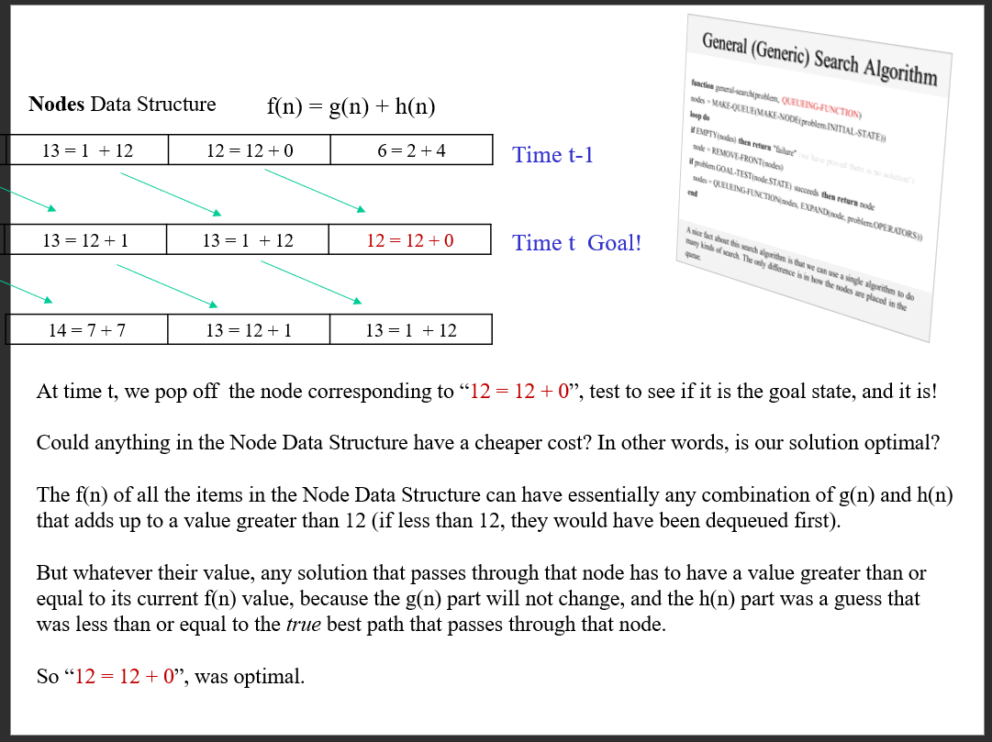

Slide 26
How fast is A*?
A* is the fastest search algorithm. That is, for any given heuristic, no algorithm can expand fewer nodes than A*
How fast is it? Depends on the quality of the heuristic
If the heuristic is useless (ie h(n) is hardcoded to equal 0), the algorithm degenerates to uniform cost
If the heuristic is perfect, there is no real search, we just march down the tree to the goal
Generally, we are somewhere in between the two situations above. The time take depends on the quality of the heuristic

Slide 27
What is A*’s space complexity?
A* has worst case O(b^d) space complexity, but an iterative deepening version is possible, IDA*
IDA* has a space complexity of just O(bd)

Slide 28
A*’ is the last word
There is no way to beat A*
So all research is on creating better heuristics

Slide 29
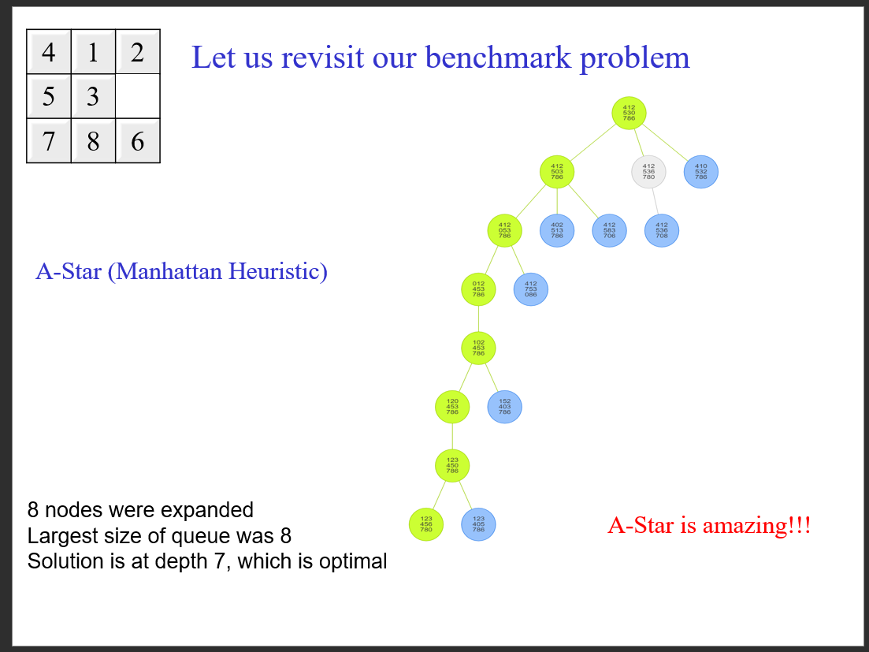

Slide 30
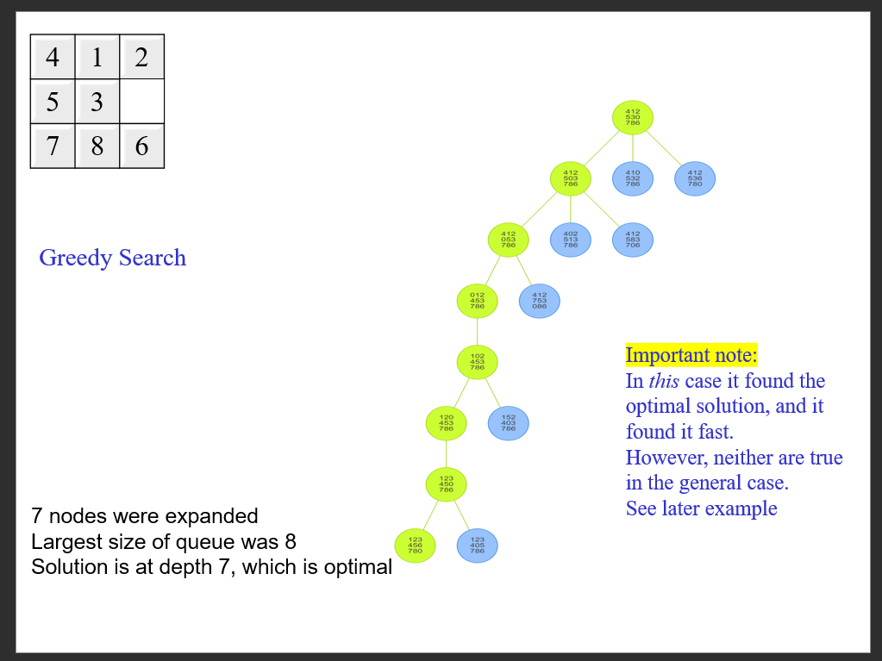

Slide 31
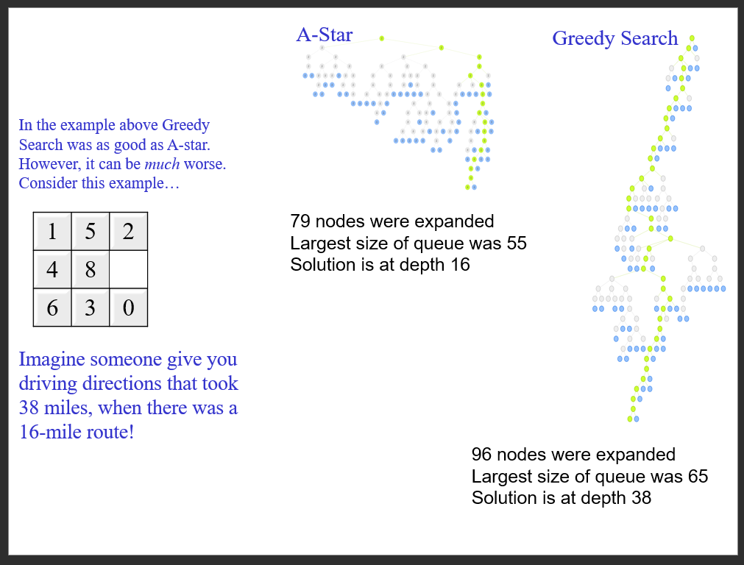

Slide 32
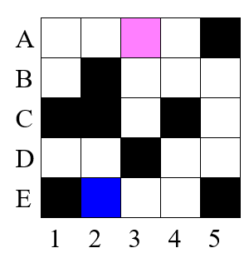
A worked example: Maze traversal
Problem: To get from square A3 to square E2, one step at a time avoiding obstacles (black squares)
Operators: (in order)
go_left(n)
go_down(n)
go_right(n)
Each operator costs 1
Heuristic Manhattan distance

Slide 33
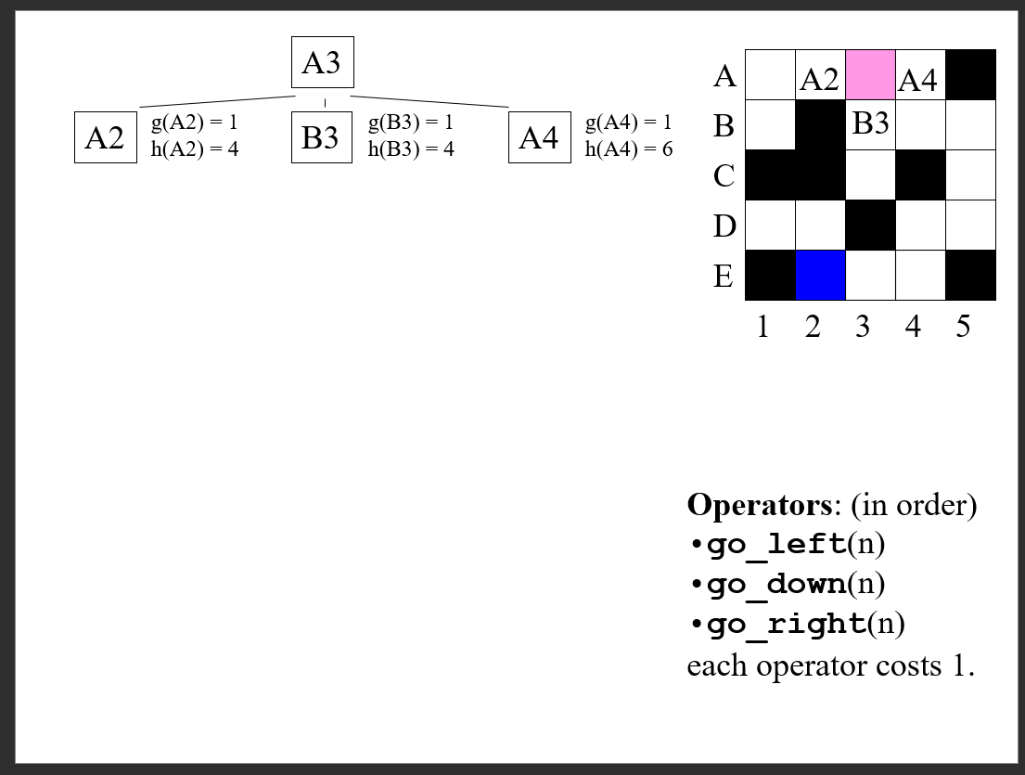

Slide 34
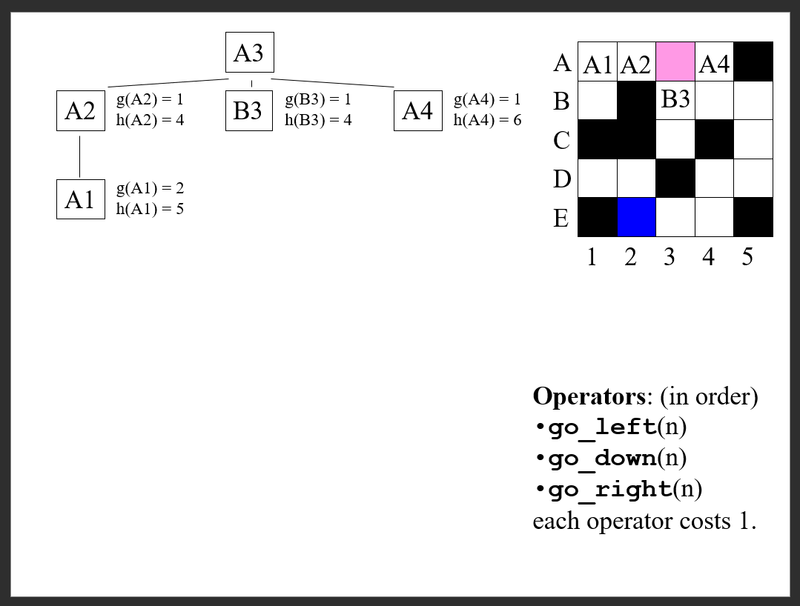

Slide 35
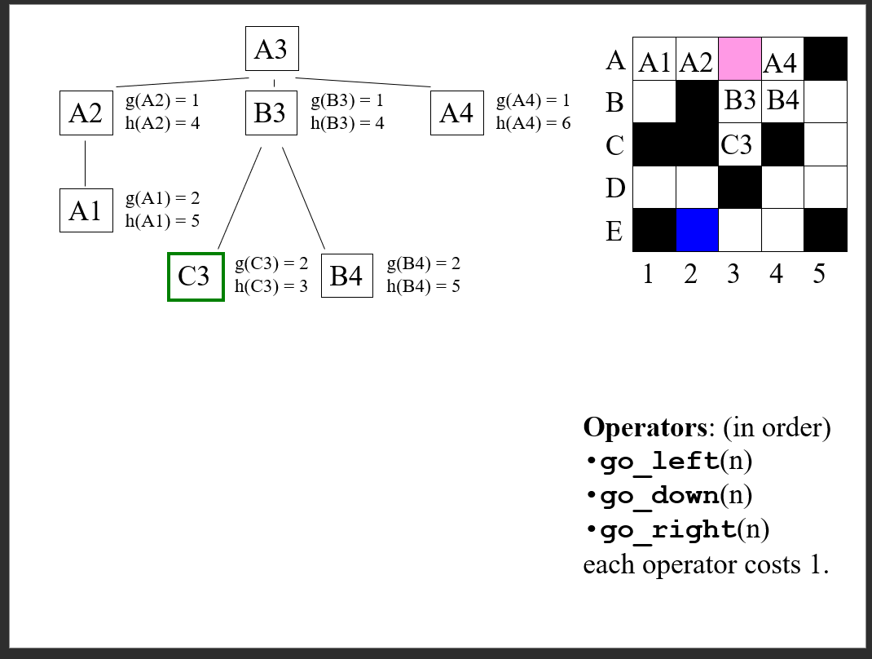

Slide 36
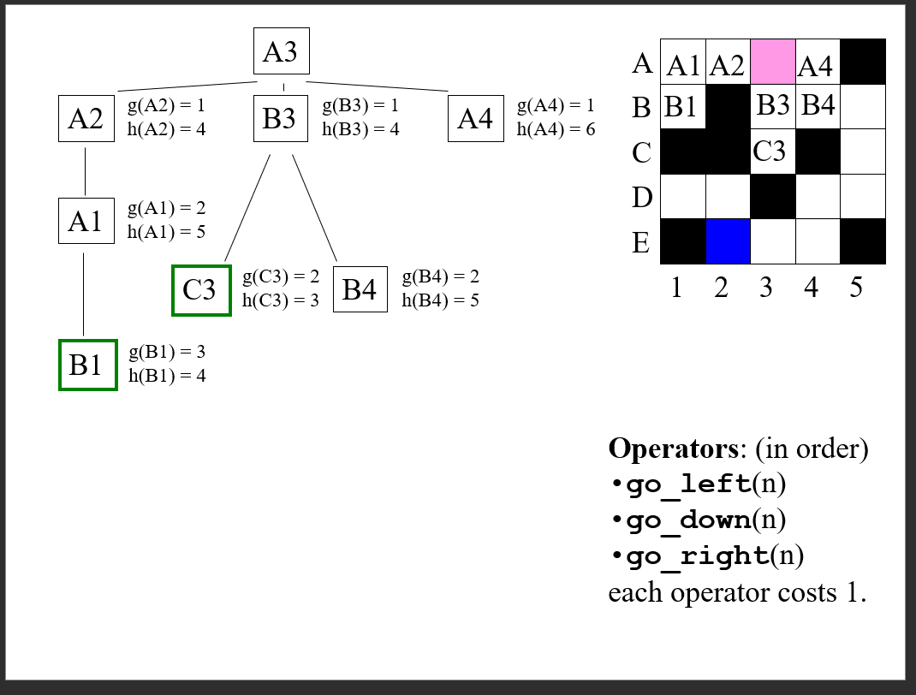

Slide 37
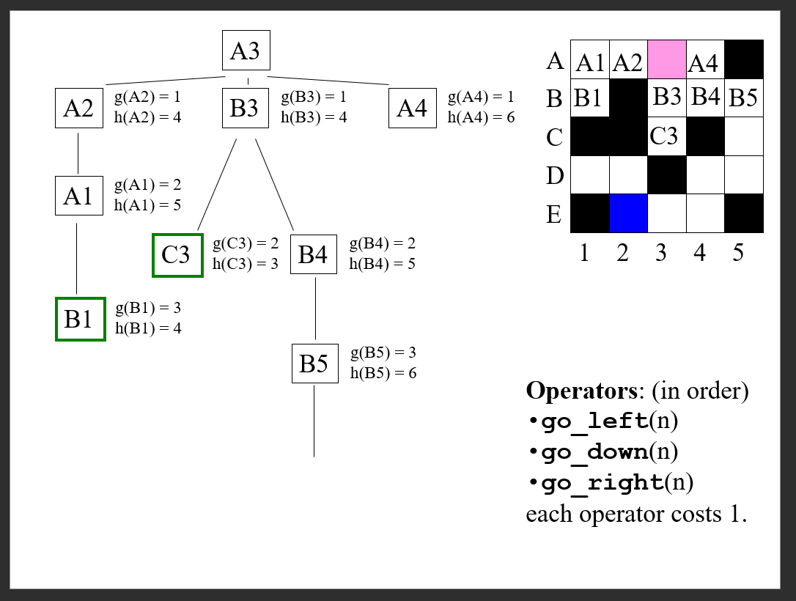

Slide 38
There is a very nice tool for “playing: with search on a grid
https://quao.github.io/PathFinding.js/visual/
Note that what this tool calls best-first-search we have been calling hill climbing search

Slide 39
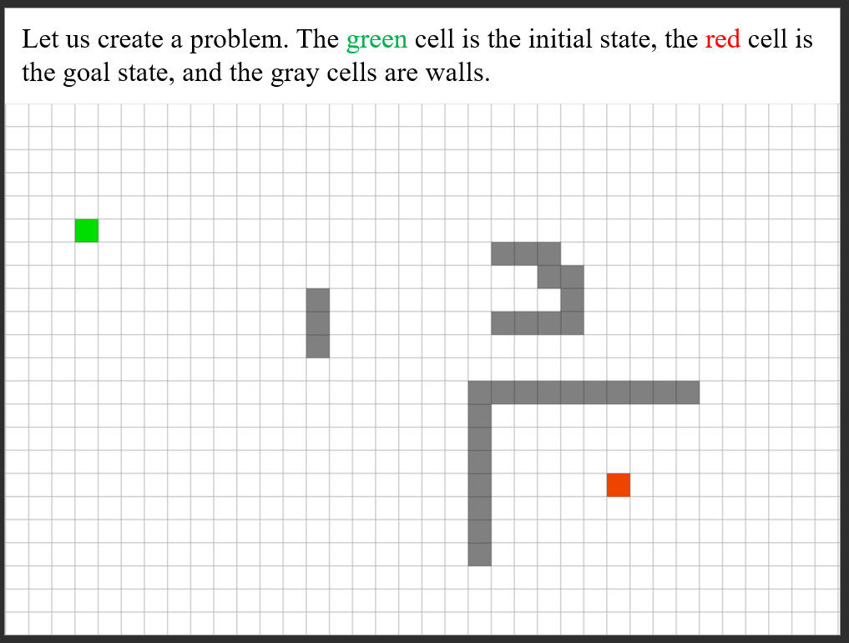

Slide 40
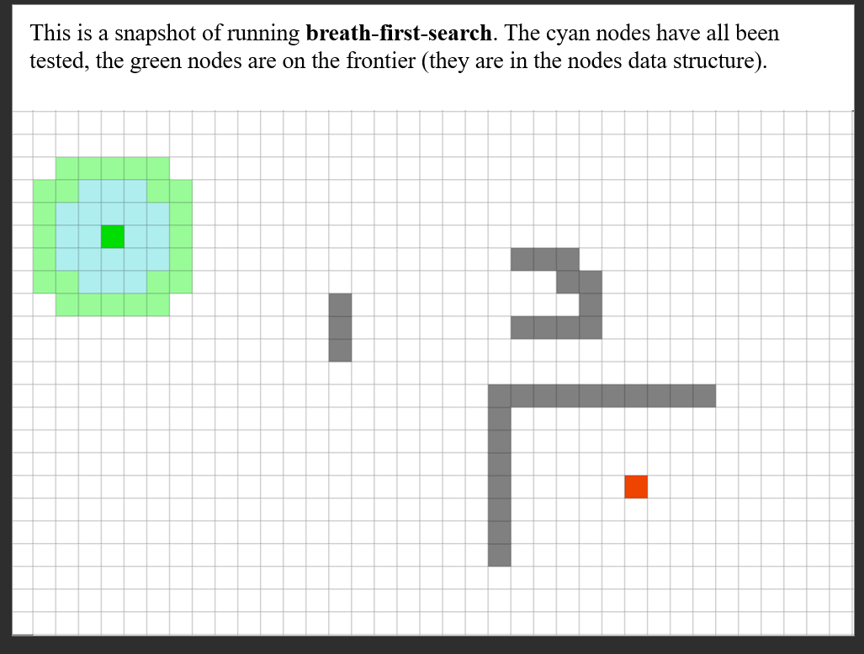

Slide 41
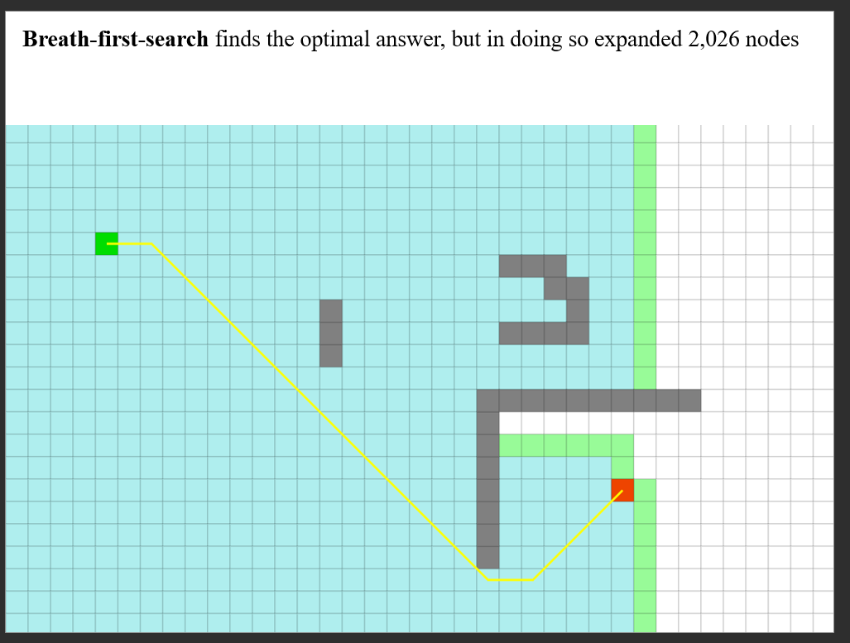

Slide 42
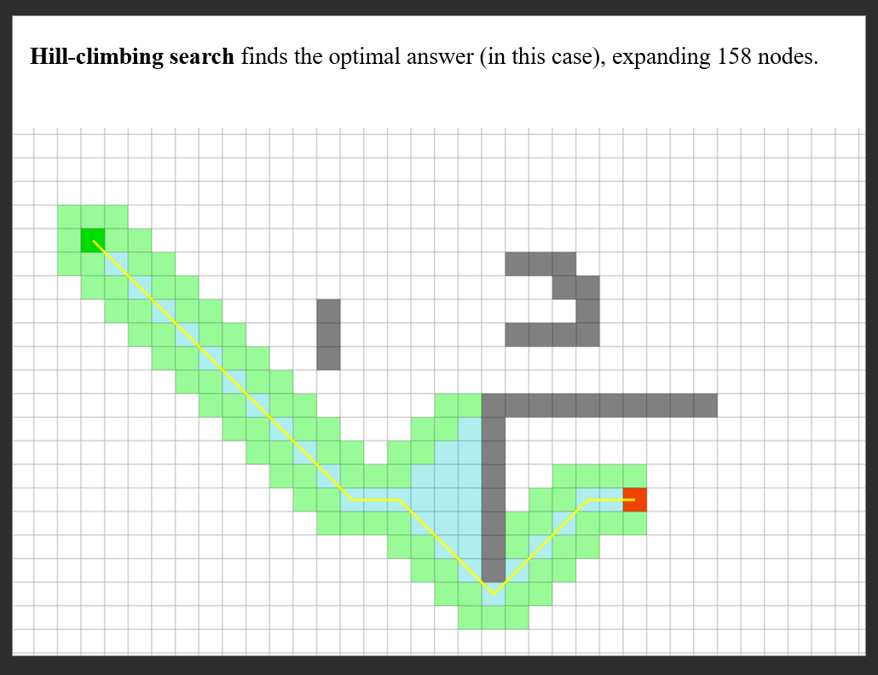

Slide 43
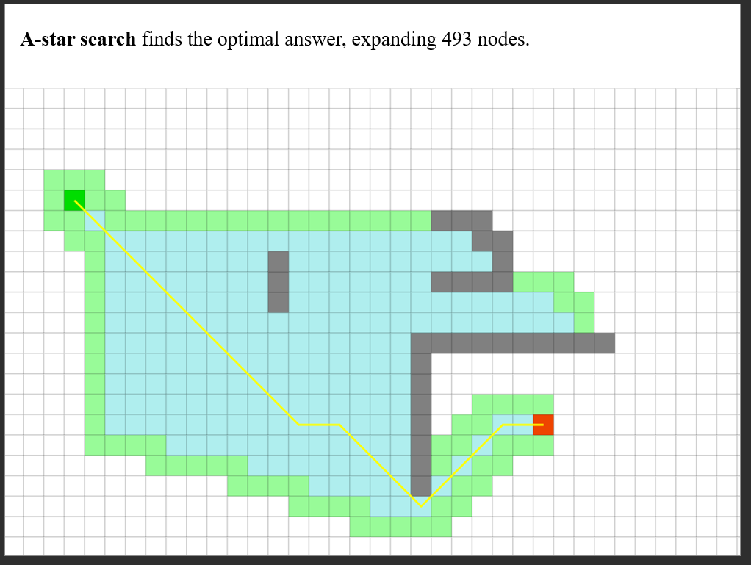

Slide 44
From the previous example, it seems that greedy search is a good algorithm. It gave the optimal answer here, and expanded fewer nodes
However, it is possible to have a simple problem where greedy search gives a very very poor answer, and/or expands more nodes
Lets see an example

Slide 45
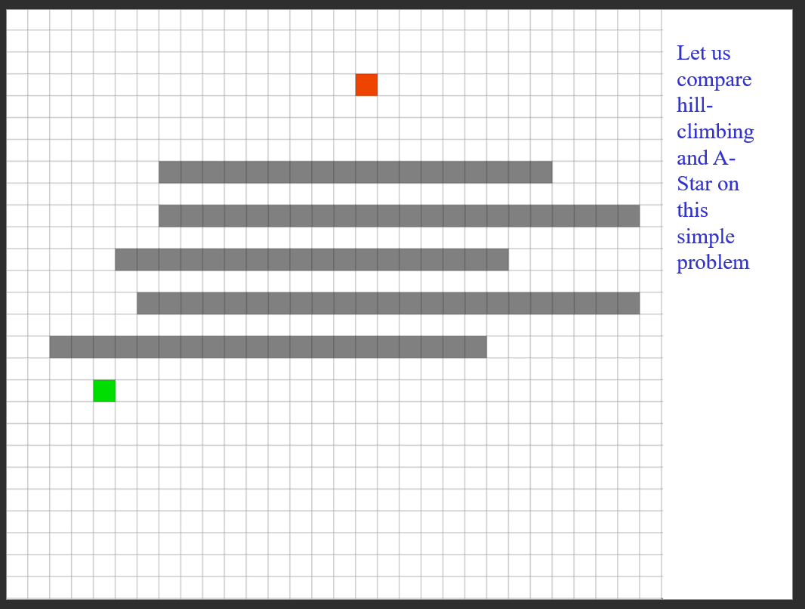

Slide 46
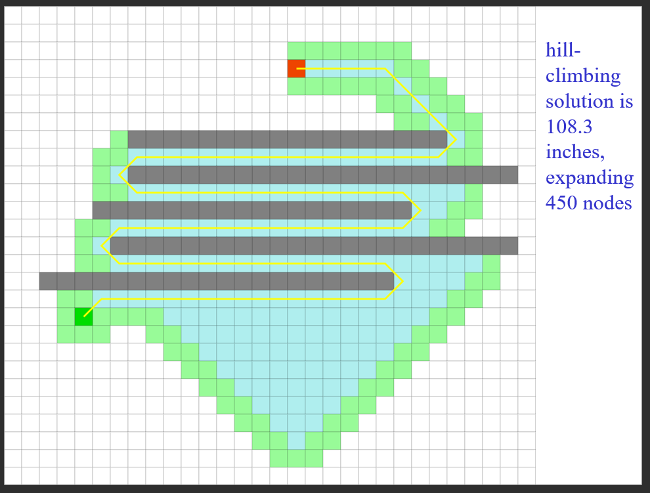

Slide 47
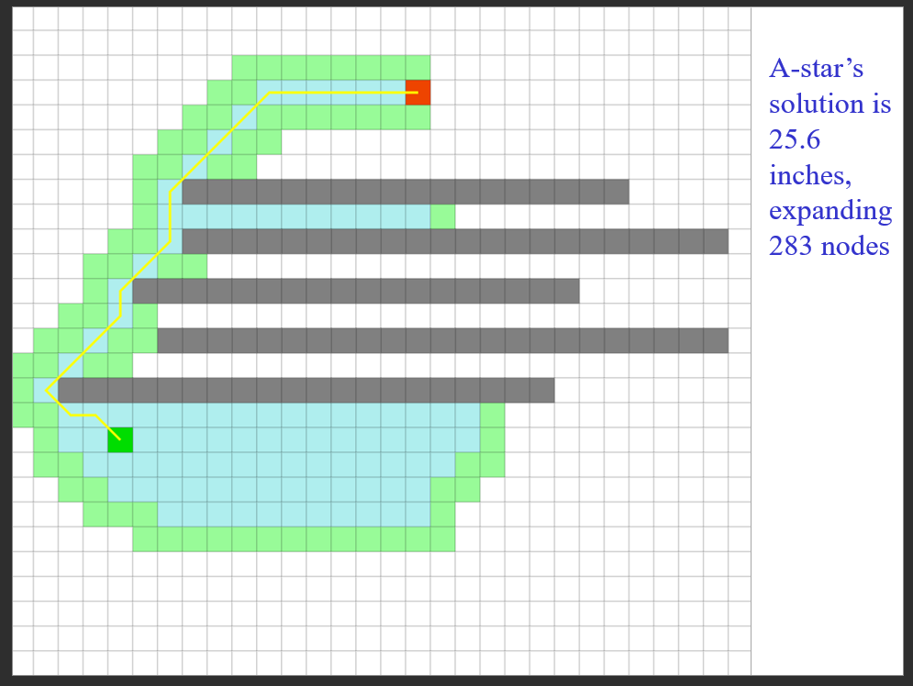

Slide 48
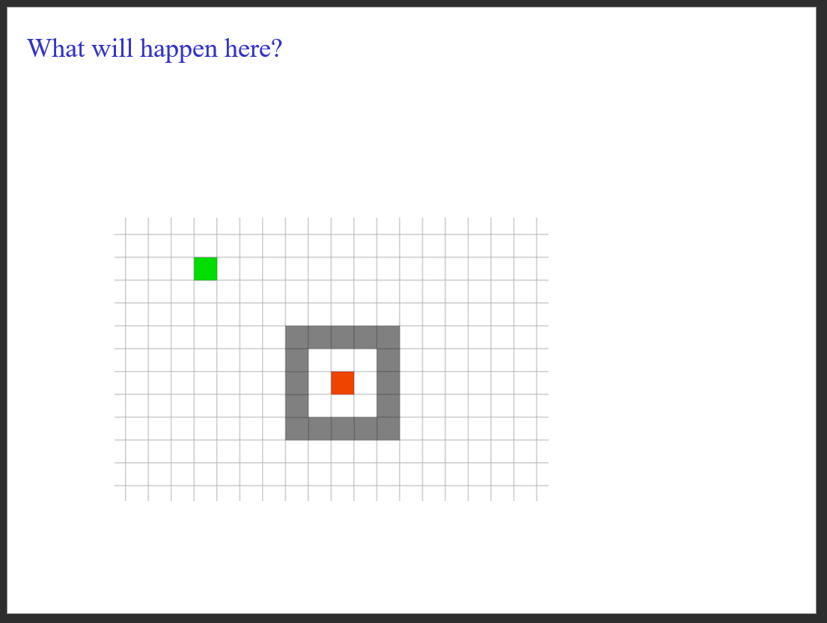

Slide 49
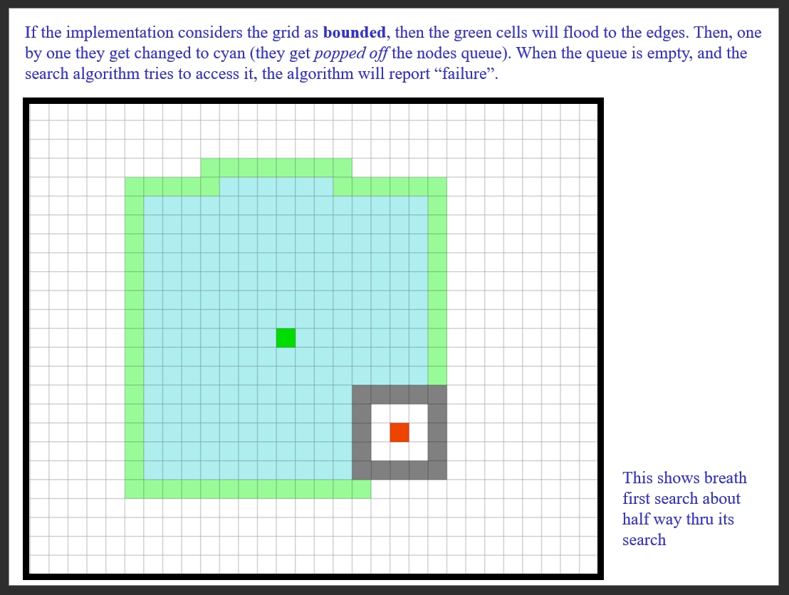

Slide 50
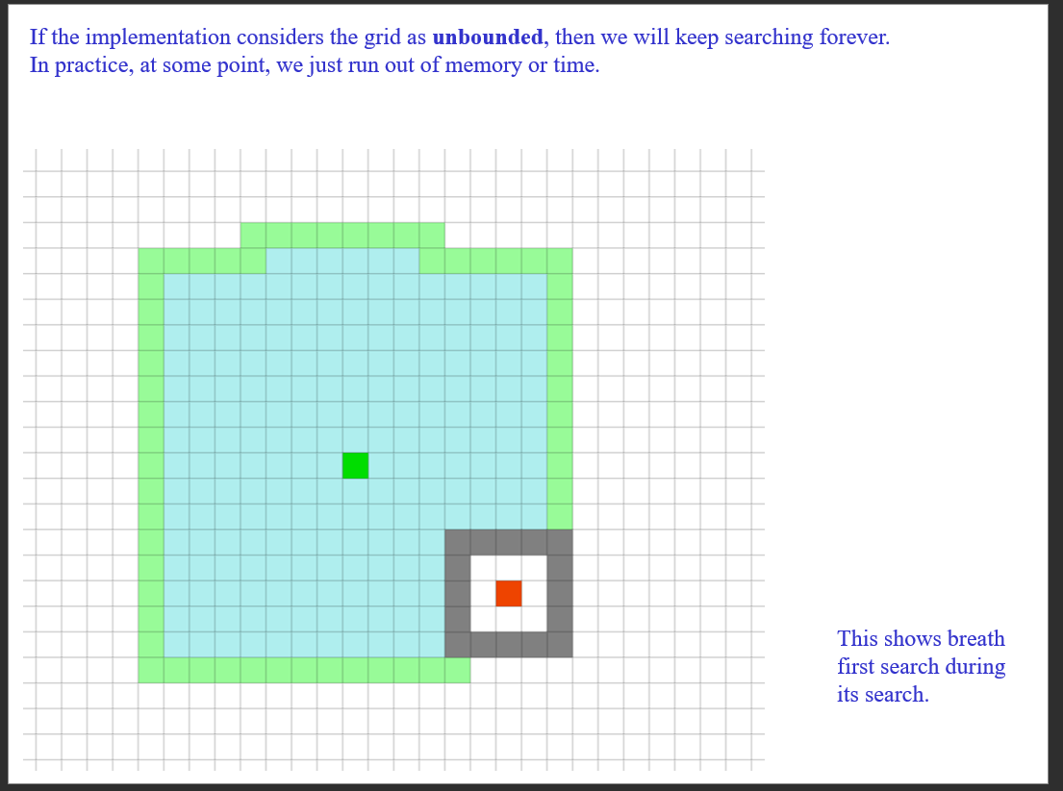

Slide 51
